Slide 1
OSINT APPLICATION
Team Member
Dipika Bhandari: A20554676
Rana Feyza Soylu: A20465152
Saikrishna Laxmipathi Gundeti: A20553118

Slide 2
Contents
Scope
Project Background
Project Link
Project Scope and Deliverables
Project Timeline
Project Budget
Project Risks
List of Potential Risk
Project Risk
Risk Management Log
Data Analysis
Completion Phases

Slide 3

Scope
The objective of this project is to create OSINT tools that can gather and examine publicly available data in order to project insights that can be applied to additional research.

Slide 4
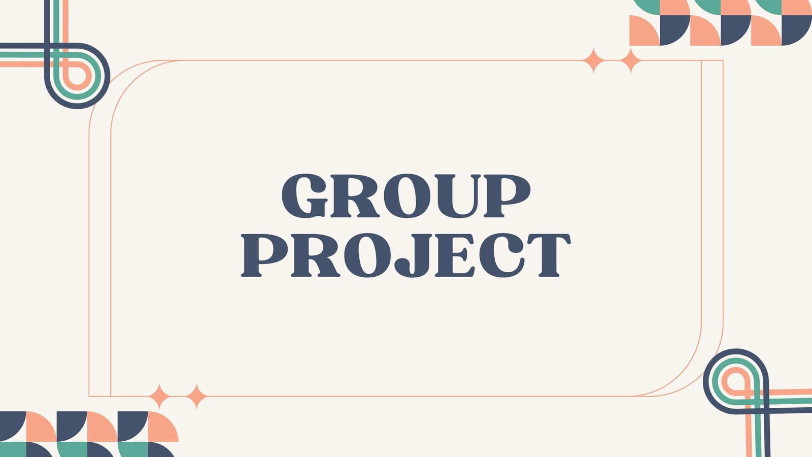
Project Background
The OSINT web application project aims to design, develop, and deploy an online platform for obtaining OSINT data. The application will allow users to input names and retrieve complete data from social media platforms, including Twitter, Reddit, Instagram, and weather.

Slide 5
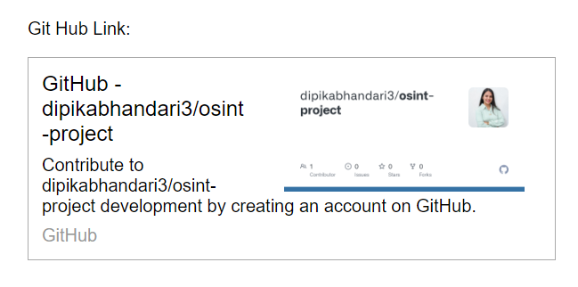
Project Link

Slide 6
Project, Scope and Deliverables
PROJECT PHASE | SCOPE | DELIVERABLES
Planning | Describe the project's scope. Determine who the key project participants are. Making a Project Schedule | Launch Project and goals Establish a workspace for development.
Development | Create and carry out the specifications and requirements for the unique OSINT application. | Core feature-rich functional application prototype, or Minimum Viable Product (MVP).
Testing | Test the program thoroughly. Find and fix any flaws, inconsistencies, or defects. | Test results, bug tracking paperwork, and a program free of errors that is prepared for release.
Documentation | Make thorough documentation, such as system architectural diagrams, user manuals, and technical requirements. | Documentation for APIs and user guides. Technical documents and schematics of system architecture.
Deployment | Get the application ready for implementation. Making sure the transfer goes smoothly Best possible outcome. | Installed and configured the OSINT program successfully, making it usable by end users Documentation required for upkeep or assistance.

Slide 7
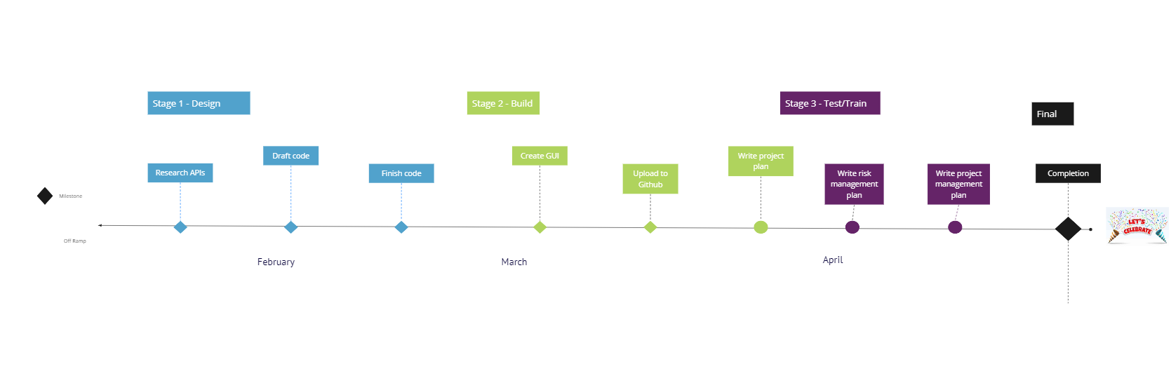
Project Timeline

Slide 8
Project Budget
Come up with ideas
Plan for Project Management
Development of Applications
Plan for Risk Management
Experimenting
Examination
Implementation.

Slide 9
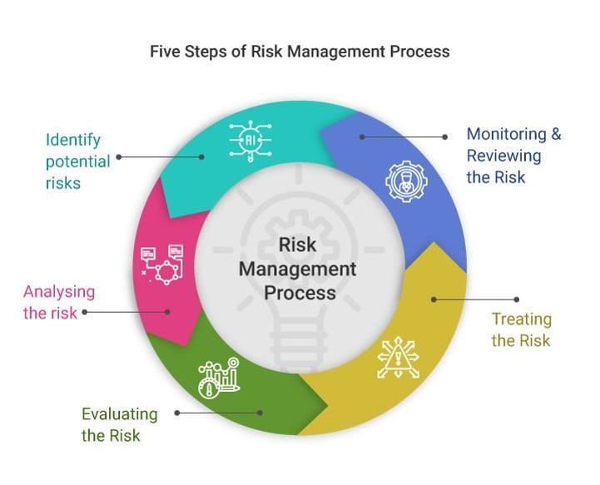
Project Risks
A project's risk management is an essential component. It entails anticipating possible problems before they become serious, evaluating them, and creating strategies to lessen or eliminate them. This is an ongoing process that has to be reviewed on a frequent basis as the development cycle progresses.

Slide 10
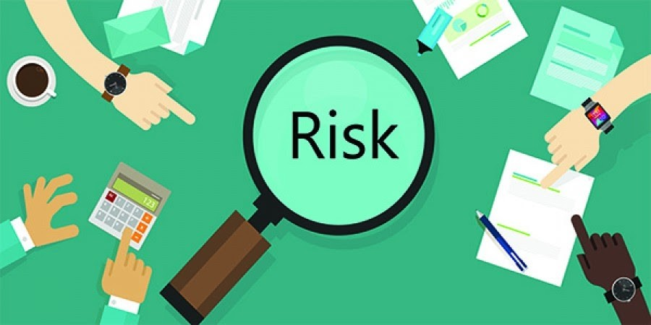
List of Potential Risk
Postponed Evolution
Abuse of privately APIs
Vulnerabilities in Security
Modifications to the API endpoints or authentication protocols
Reliance on other libraries or resources
API rate limitations and quota constraints
APIs might be restricted in their use or deprecated without warning.
Clarity is lacking in the communication
The availability of knowledgeable developers
Certain systems might not have a publicly accessible API for retrieving data.

Slide 11
Project Risks
Risk Identification: Identifying any hazards related to our project by research, brainstorming discussions, and the application of previous project experiences. This might involve issues with dependability, collaboration, timeline, technical difficulties, security, strategy, project resources, project management, or team communication.
Evaluation of Risk : After each risk has been identified, rate its chance of happening (high, medium, low) and consider its possible effects on the project (high, medium, low). These numbers were multiplied to calculate the risk priority, which made it easier to concentrate on the most important problems.
Reduced Risk: Mitigation techniques were created for high-priority threats. This included developing clear communication channels among the team, having backup plans for technological difficulties, and locating other data sources, among other things.
Observe and Evaluate: The procedure for managing risks is continuous. regular evaluation of the risk register, updating assessments as the project develops, and modifying mitigation plans as necessary.

Slide 12
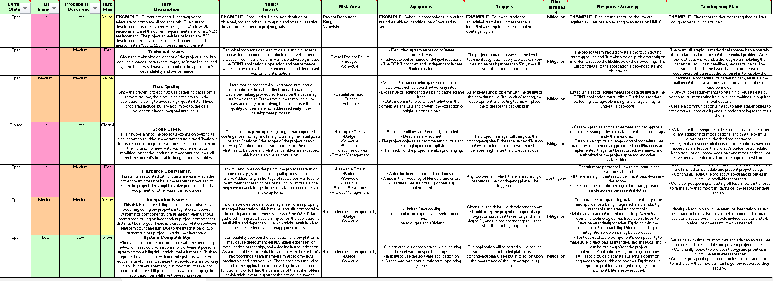
Risk Management Log

Slide 13
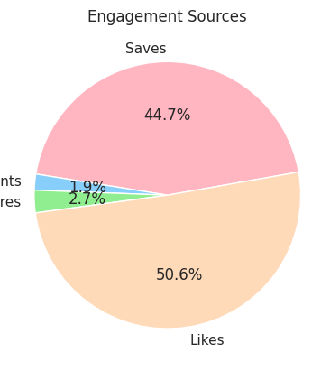
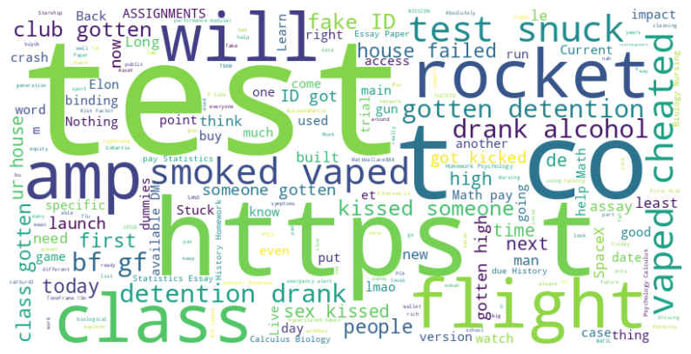
Data Analysis

Slide 14
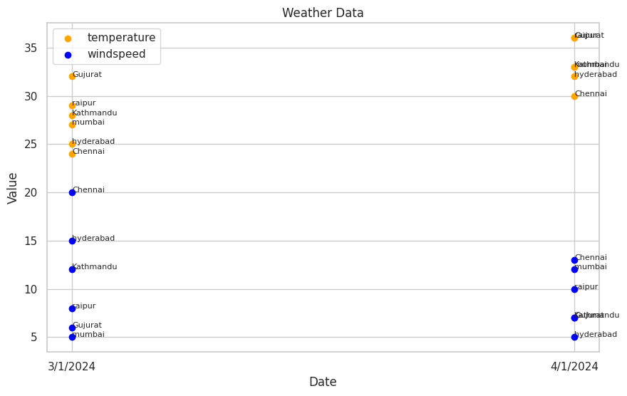
Data Analysis

Slide 15
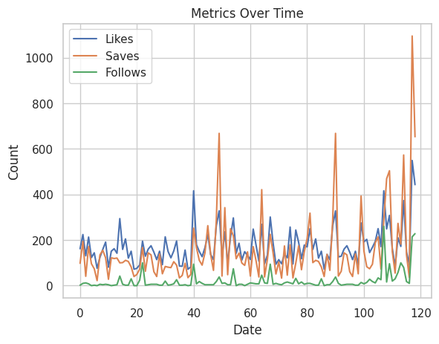
Data Analysis

Slide 16
Completion Phases
Step 1: Collecting and Analyzing Requirements
Step 2: Conceptualization and Modeling
Step 3: Design and Evaluation
Step 4: Implementation and Upkeep

Slide 17


